Slide 1
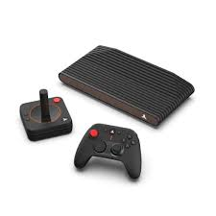
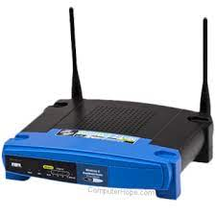
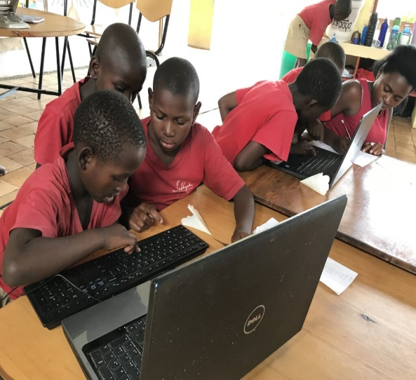
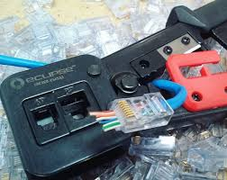
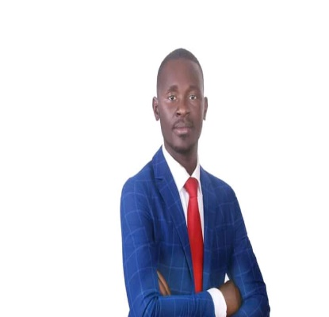
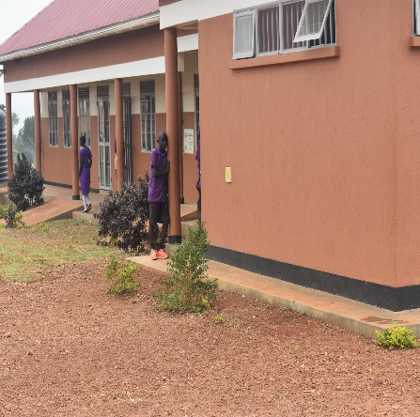
MAKERERE UNIVERSITY OMALA GEORGE REAL LIFE PROJECT ZION IT SOLUTIONS.
UBB-JJA/2021/T/D/M/102

Slide 2
COMMUNITY PHYSIBLITY STUDY IN ICT FIELD
In our study we realized the following;
In 10 km I found out that there was no any company providing services in the ICT field. In every 10 group of people only 1 had an ICT related knowledge. There is no any organized computer training center in a circumference of 17km The local computers don’t know the reality of a technological world. Due to advancing technological era as a lot registration and payments are now done online there is a technological gap in the local communities that the locals can not easily transact using search online portals. Informatin access and sharing is so hard for the local communities because of lack of devices,internet and sharing centers.

Slide 3

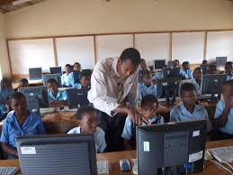
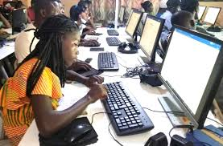

ABOUT ZION IT SOLUTIONS
Tongolo trading center , Nyenga division ,njeru municipality.
To impact the community in terms of computer knowledge and enable flow of information.
To have a computer training center that will help to equip the locals with computer and other related skills.
Location:
mission:
Vision:

Slide 4
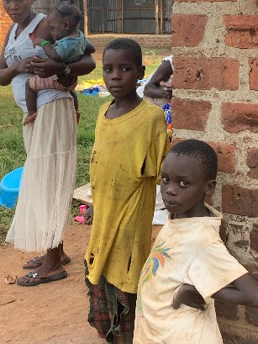
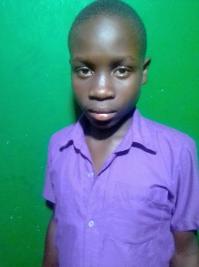
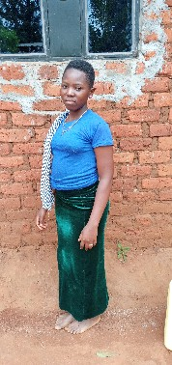
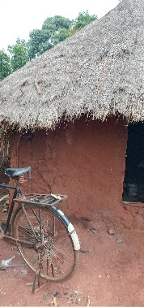
PROBLEM IDENTIFIED IN THE COMMUNITY.
Computer illiteracy in the local communities and inaccessibility to information .

Slide 5
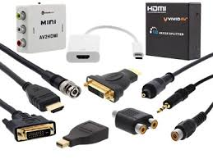
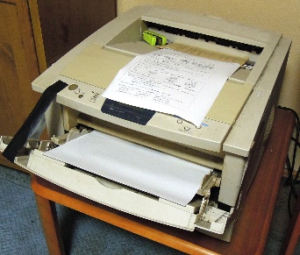
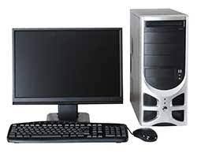
REQUIREMENTS.
Computers.
Seats.
Router.
Switch.
Printer
Scanner.
Cable
Internet
Repair tools.
Networking tools.

Slide 6


OUR SOLUTION.
computer lessons .
Gaming.
Internet services.
Printing and photocopying.
Online payments.
Networking.
Web design.
We hope to solve the problems through the following;

Slide 7
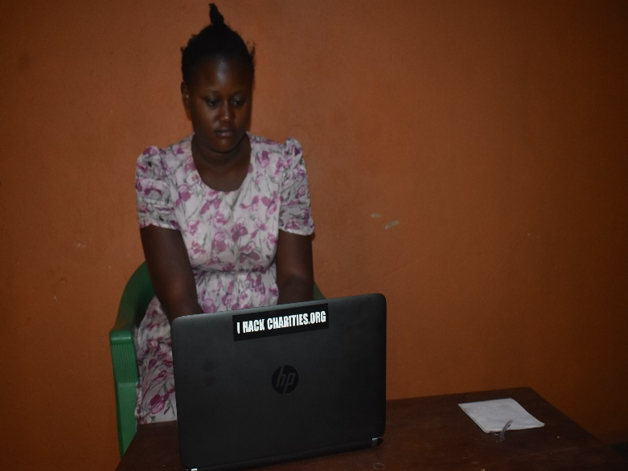
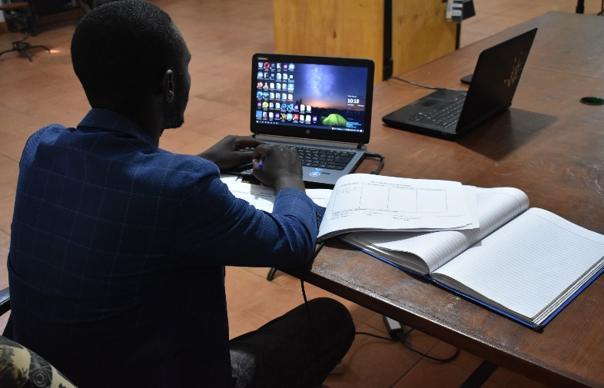

WHERE WE ARE SO FAR.
We have the following in place already;
4 computers on board.
A printer.
Cables.
Networking tools.

Slide 8
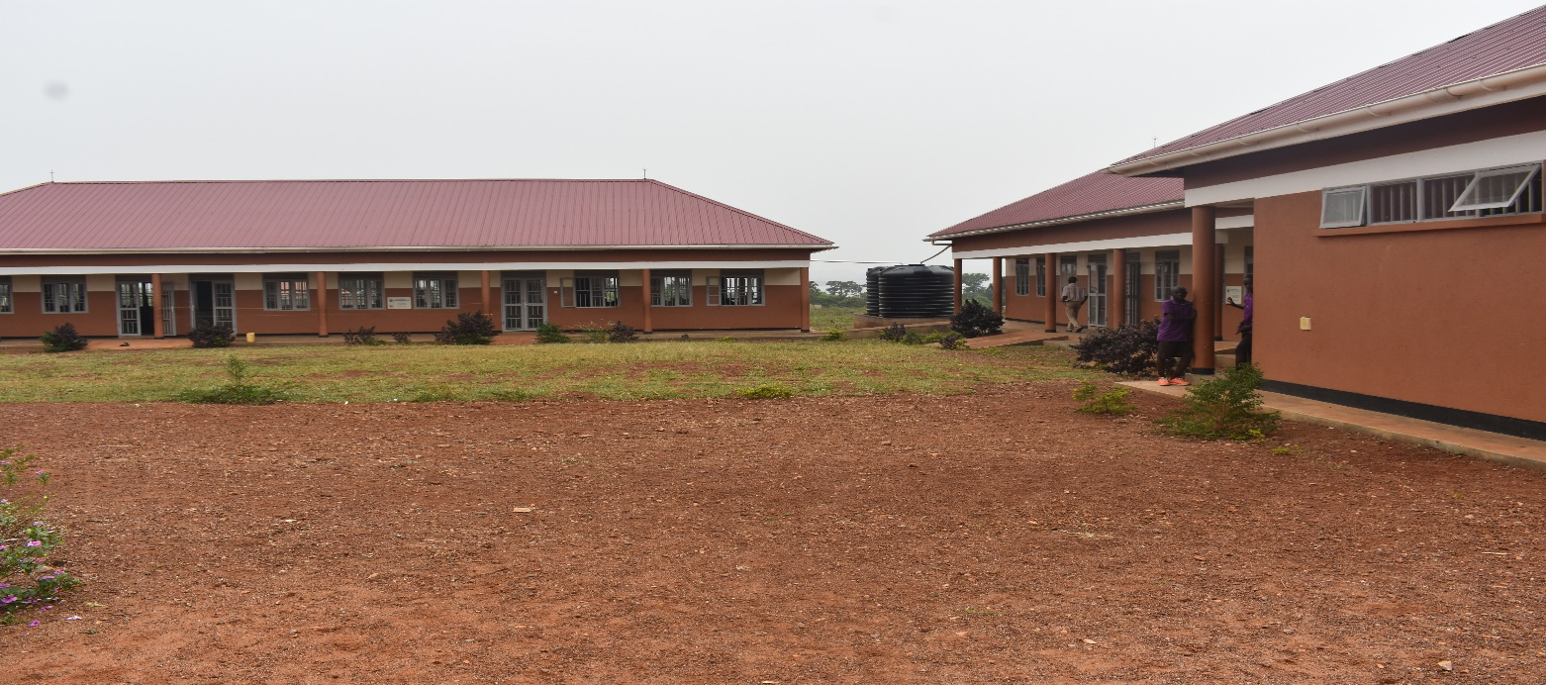
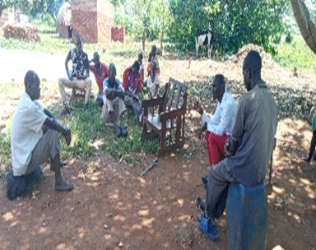

MARKETING STRATEGIES.
Through engaging the parents in the communities to know why every child should have some computer skills. sensitizing the communities on the goodness of computer skills in this modern world. Engaging the schools calling pupils to join the computer classes. Through advertisement on the local platforms.

Slide 9
CAPITAL REQUIREMENTS.
REQUIREMENT | UNIT PRICE | TOTAL
Networking tools | 100,000 | 100,000
Repairing toolkit | 150000 | 150000
Router | 250000 | 250000
Switch | 350000 | 350000
Computers | @450000 | 450000*13 = 5,850,000
printer | 1.5m | 1,500,000
internet | 450000 | 450,000
TOTAL: 8,650,000

Slide 10
OUR DAY-TODAY EXPENDITURE.
category | Attachment | Expense per day
power | Admiration | 5000
Breakfast | 3 team members | 2000*3 = 6000
lunch | 3 team members | 3000*3 = 9000
Transport | 3 team members | 5000*3 = 15000
Total : 35000*30 = 1050000 per month

Slide 11

EXPECTED REVENUE.
SERVICE | UNIT PRICE | TOTAL IN A MONTH
Computer class | 150000 a term of 3 months | 13*150000 = 1950000/3
gaming | 500 | 500*5*30 =75000
Wi-Fi internet services | 20000 per month | 20000*10 = 200000
Website | 450000 | 450000/3
Printing and photocopying | 5000 per day | 5000*30 = 150000
Total: 1225000

Slide 12
OUR HEALTH PRECAUTIONS
We regulate the time our clients spend on computers for not to effect their eyes. We have provided chairs that don’t affect our clients’ backs even if they sit for a long time. We have provided sanitizer to fight the spread of covid19 also. We have used only insulators wires curb the problem of power chokes at the facility. We have installed lighting arresters to curb the lighting at the facility.

Slide 13
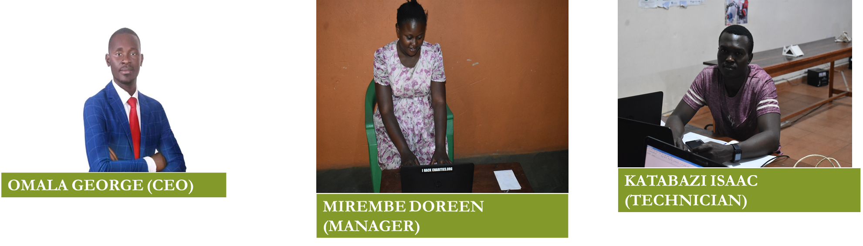
MY TEAM.

Slide 14
COMPETITORS.
US.
OTHER COMPETORS
Accessible due to good location
Affordable prices compared to others
There is customer satisfaction.
Inaccessible.
Higher prices
Little customer satisfaction

Slide 15
CONCLUSION
Through ICT we can change our local communities by making information access easy, through having access to information there can be innovation and inventions in the different sectors.
thanks yours
OMALA GEORGE.

